Slide 1
Phishing
Provided by the MCINCR-MCBQ Operations Security (OPSEC) Program Coordinator
2022

Slide 2
Overview
OPSEC Overview
What is Phishing
IRS and Phishing
Spear Phishing
Whaling
Cat Phishing
Vishing
Smishing
Identification of attack and how to protect against
NOST Contact Info

Slide 3
References
Department of Defense Instruction (DoDI) 8170.01, 2 January 2019, Online Information Management and Electronic Messaging
SECNAVINST 3070.2A, 9 May 2019, Operations Security
NTTP 3-13.3M / MCTP 3-32B, September 2017, Operations Security
SECNAVINST 5720.44C W/CH-2, 21 February 2012, DON Public Affairs Policy and Regulations
Navy Social Media Handbook (2019)
Notes:
-Explain that the SECNAV Instruction is the Navy's OPSEC instruction dated May 2019.
-The DoD Instruction is the DoD's Internet Services and Internet-Based Capabilities, applications and messaging, 2 January 2019

Slide 4
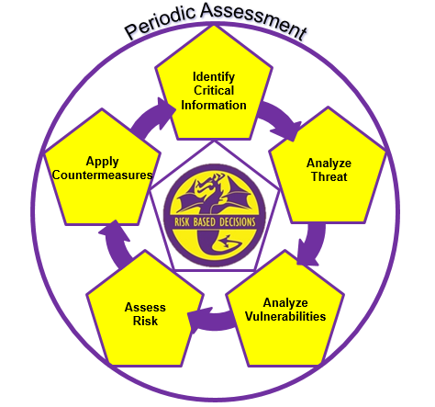
Operations Security
OPSEC is a cycle that identifies critical information, analyzes potential threats and vulnerabilities, assesses risk, develops countermeasures to safeguard critical information, and periodically assesses the effectiveness of the units OPSEC posture.
Notes:
Operations Security: 1. A systematic, proven process by which a government, organization, or individual can identify, control, and protect generally unclassified information about an operation/activity and, thus, deny or mitigate an adversary's/competitor's ability to compromise or interrupt said operation/activity (NSC 1988). 2. OPSEC is a cycle of identifying critical information and subsequently analyzing friendly actions attendant to military operations and other activities to (a) identify those actions that can be observed by adversary intelligence systems, (b) determine indicators adversary intelligence systems might obtain that could be interpreted or pieced together to derive critical information in time to be useful to adversaries, and select and execute measures that eliminate or reduce to an acceptable level the vulnerabilities of friendly actions to adversary exploitation (DOD JP 1994; JCS 1997).
Operations Security Cycle: An analytical cycle that involves six steps: identification of critical information, analysis of threats, analysis of vulnerabilities, assessment of risks, application of appropriate countermeasures and periodic assessment of effectiveness. (NSPM-28).
Completing this cycle will allow commanders to make informed risk based decisions on what information they need to protect and how to protect it.

Slide 5
Phishing
Phishing is an illegal activity using social engineering techniques to fraudulently solicit sensitive information or install malicious software.
Objective is to gain knowledge of sensitive information
Usernames/passwords
Personal information
Military operations
Financial information
Notes:
Phishing is a criminal mechanism employing both social engineering and technical subterfuge to steal consumers’ personal identity data and financial account credentials. Social engineering schemes use spoofed e-mails
purporting to be from legitimate businesses and agencies, designed to lead consumers to counterfeit websites that trick recipients into divulging financial data such as usernames and passwords. Technical subterfuge schemes plant crimeware onto PCs to steal credentials directly, often using systems to intercept consumers online account user names and passwords -- and to corrupt local navigational infrastructures to misdirect consumers to counterfeit websites (or authentic websites through phisher-controlled proxies used to monitor and intercept consumers’ keystrokes).
Operations Security: 1. A systematic, proven process by which a government, organization, or individual can identify, control, and protect generally unclassified information about an operation/activity and, thus, deny or mitigate an adversary's/competitor's ability to compromise or interrupt said operation/activity (NSC 1988). 2. OPSEC is a process of identifying critical information and subsequently analyzing friendly actions attendant to military operations and other activities to (a) identify those actions that can be observed by adversary intelligence systems, (b) determine indicators adversary intelligence systems might obtain that could be interpreted or pieced together to derive critical information in time to be useful to adversaries, and select and execute measures that eliminate or reduce to an acceptable level the vulnerabilities of friendly actions to adversary exploitation (DOD JP 1994; JCS 1997).
Operations Security process: An analytical process that involves five components: identification of critical information, analysis of threats, analysis of vulnerabilities, assessment of risks, and application of appropriate countermeasures (NSC 1988).
Source: http://www.ioss.gov/glossary.html#o

Slide 6
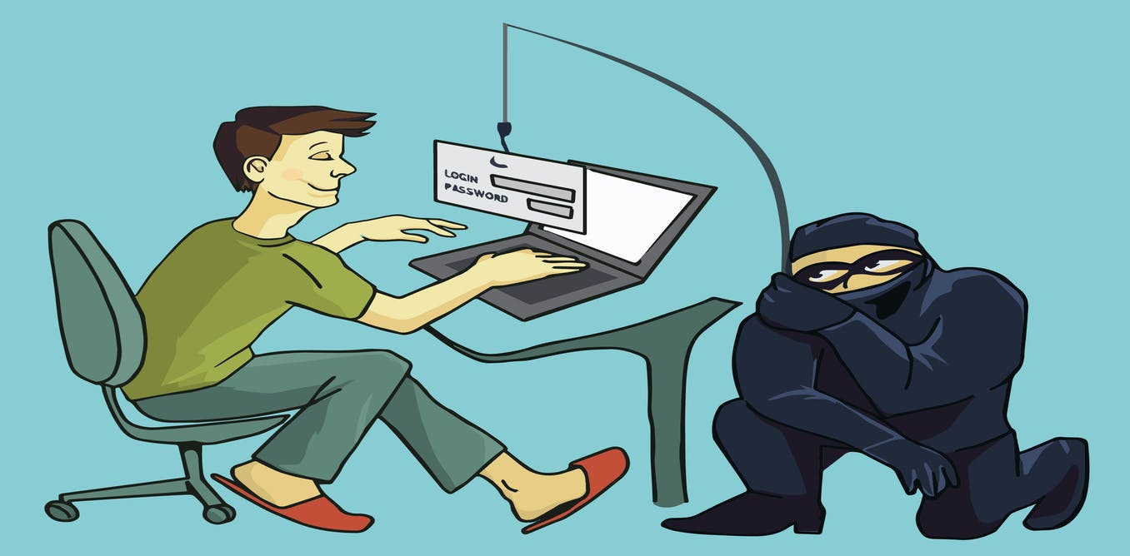
Phishing Attack
Characterized by a lure, hook, and catch
The Lure
The lure is an enticement delivered through email. The email contains a message encouraging the recipient to follow an included hypertext link. The hyperlink often masks a spoofed uniform resource locator (URL) of a legitimate website.
The Hook
The hook is a malicious website designed to look and feel like a legitimate website. The authentic-looking website asks the victim to disclose privacy-related information, such as user identification and password. Often the hook is an obfuscated URL that is very close to one the victim finds legitimate and is really a site under the attacker’s control.
The Catch
The catch is when the originator of the phishing message uses the information collected from the hook to masquerade as the victim and conduct illegal financial transactions.
Notes:
These three elements are present in the majority of phishing attacks. If the attacker is successfully able to accomplish the first two steps the third is almost inevitable.

Slide 7
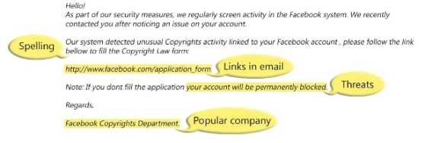
Phishing
Phishing:
Attempts, via email, to acquire personal information from an Internet user by pretending to be a credible source
Indicators:
Spelling errors (they have improved)
Links in the email (malicious)
Communicated threats
Will be from a prominent business or company
Notes:
-Sometimes you’ll still see spelling errors, but the “bad guys” are getting much better, and oftentimes they’ll be no grammar or spelling mistakes.

Slide 8
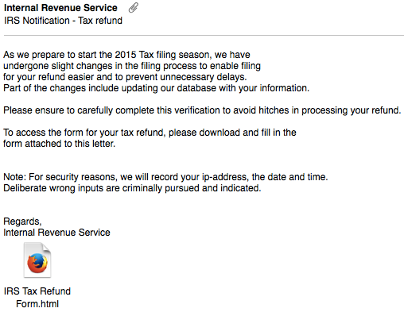
Internal Revenue Service
Phishing Remains on the IRS “Dirty Dozen” List of Tax Scams
The IRS does not initiate taxpayer communications through email
Scammers send email claiming to be from IRS
Requests that you click on a link to fill out a form
Malicious link
Form asks for personal information
Notes:
-One of the most popular phishing techniques, especially around tax season.
-IRS does not send these types of emails.
-Report these attempts to phishing@irs.gov
Phishing Remains on the IRS “Dirty Dozen” List of Tax Scams for the 2016 Filing Season

Slide 9
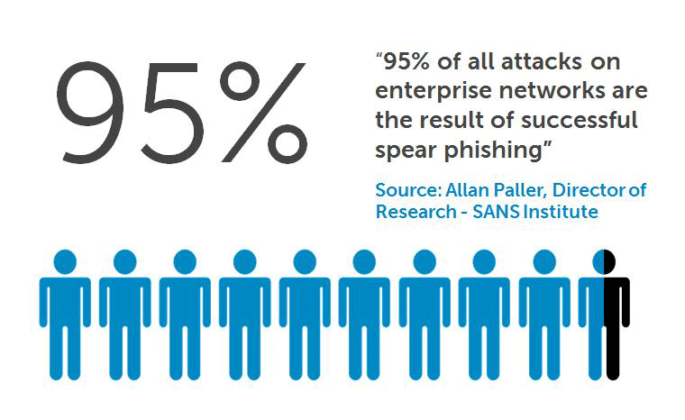
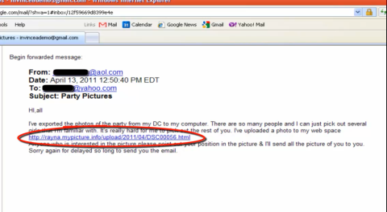
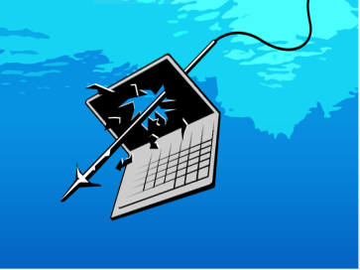
Spear Phishing
Information is collected on a person and then used to convince the individual that the sender is a legitimate entity that “knows” the victim
Notes:
Spear phishing is a new form of phishing being seen more frequently in 2015. A spear phishing attack is usually an attack targeted at an individual within a company. Attackers use specific information about their target to craft an email that is tailored toward the target. These emails often look like they are from your bank or from a close friend or relative to trick the target into believing that the message sender is authentic.

Slide 10
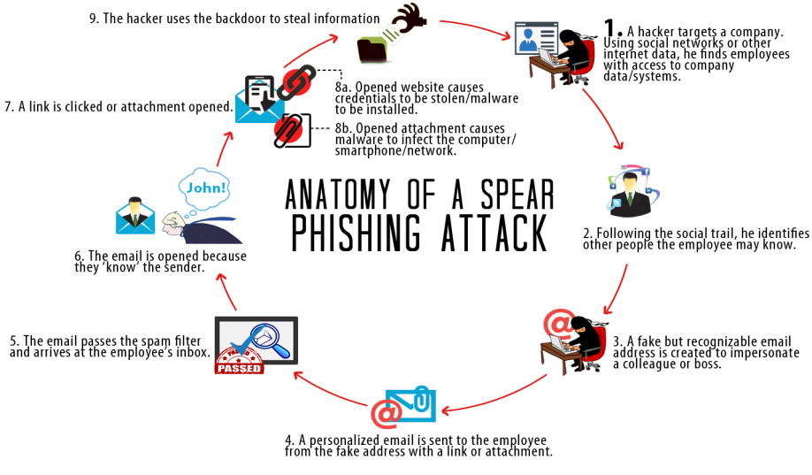
Spear Phishing
Notes:
The Anatomy of a Spear Phishing attack. Run through the steps as depicted on the slide.

Slide 11
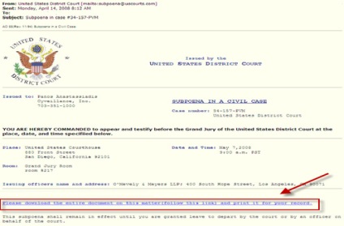
Whaling
A highly targeted phishing attack - aimed at senior executives - masquerading as a legitimate email.
Any links are most likely malicious
March 2016: Snapchat’s payroll department was targeted by an isolated email phishing scam in which a scammer impersonated a CEO and asked for employee payroll information.
Download includes a keystroke logger virus
Notes:
Snap Chat Hack 1 March 2016
http://www.dclsearch.com/snapchat-hit-by-ceo-email-scam-as-whaling-attacks-increase/
The executive director of finance at a New Zealand finance institution called Te Wananga o Aotearoa left her job when she sent $118,000 to an offshore bank account after receiving an email that appeared to be from the firm’s chief executive telling her to move the money. “Some of the most successful phishing attacks are those that successfully impersonate a person, particularly if that person is well known to the recipient,” he said.

Slide 12
Cat Phishing
A scam where someone, the ‘catfish,’ creates a fictitious online identity and seeks online relationships.
Frequently romantic relationships
Online dating websites and cell phone dating apps are fertile hunting ground for catfish
How to recognize Cat Phishing?
They’re too good to be true
Their profile is new or incomplete
They move quickly
They won’t meet you
Notes:
How to recognize Cat Phishing?
They’re too good to be true - May be the earliest warning sign. Catfish generally create fake online identities to seem more attractive than they really are.
Their profile is new or incomplete - Catfish have to keep details of an assumed identity straight, limiting the number of photos and personal information.
They move quickly - Catfish become very close very quickly.
They won’t meet you - This is the classic warning sign. The game is up when a fake online identity or profile is revealed. Because of this, a catfish will often avoid meeting you. Inventing stories about work emergencies, personal problems, or sick friends and relatives are common tactics for getting out of a face-to-face meeting.

Slide 13
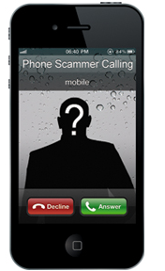
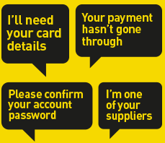
Vishing
Scam that attempts to gain personal knowledge via phone call
Imitates legitimate business
Usually warns victim of fraudulent use of credit card or bank account
Requests banking information
Notes:
Scam that attempts to gain personal knowledge via phone call
Imitates legitimate business
Usually warns victim of fraudulent use of credit card or bank account
Requests banking information

Slide 14
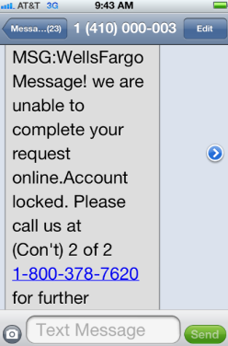
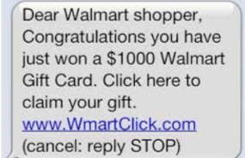
Smishing
Scam that uses text messages to trick victims into downloading a Trojan horse or virus onto their mobile device
May prompt victim to call a number
Personal information (bank, credit card, etc) will be requested
Notes:
Scam that uses text messages to trick victims into downloading a Trojan horse or virus onto their mobile device
May prompt victim to call a number
Personal information (bank, credit card, etc) will be requested

Slide 15
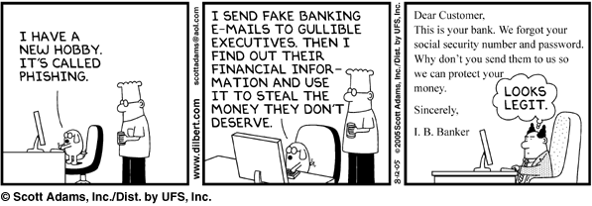
Identifying a phishing scam
Phishing scams may (or may not) have easily recognizable characteristics
Spelling and punctuation errors
Using threats to get people to give up their personal information
Enticing subject lines
Include a link to a web site requesting personal information
Notes:
Phishing scams may (or may not) have easily recognizable characteristics
Spelling and punctuation errors
Using threats to get people to give up their personal information
Enticing subject lines
Include a link to a web site requesting personal information

Slide 16
Protect yourself
Do not open emails form someone you don't know
Your bank will never email you for personal information
Visit or call the bank if you have doubt about your account
Never unsubscribe from spam emails
Mark as spam and delete
Notes:
Protect yourself from phishing scams:
-Do not register official government/.mil email accounts with any commercial websites.
-Patch/update web browsers as needed.
-Beware the unknown sender or sensational subject line.
-You will never get a free iPad, don’t fill anything out.
-When in doubt, call your financial institutions to verify if your account has been compromised.
-Do not follow links included in emails or text messages, use a known good link instead.
-Digitally sign and encrypt emails where ever possible.
-Only follow links or download attachments from digitally signed emails.
-Do not follow links to unsubscribe from spam, simply mark as spam and delete.
-Do not make security challenge answers for account validation easy to guess/learn details.

Slide 17
Summary
OPSEC Overview
What is Phishing
IRS and Phishing
Spear Phishing
Whaling
Cat Phishing
Vishing
Smishing
Identification of attack and how to protect against
NOST Contact Info

Slide 18
Contact Information
Joseph P. Riley
OpSec Program Manager
Marine Corps Base Quantico
(703) 432-6475
Joseph.p.riley@usmc.mil
OPSEC@Navy.mil or NAVY_OPSEC@us.navy.mil
757-203-3656
NAVAL INFORMATION FORCES
ATTN: NAVAL OPSEC SUPPORT TEAM
115 LAKE VIEW PARKWAY
SUFFOLK, VIRGINIA 23435

